Slide 1
CHAPTER 1:
Computers and Systems
The Architecture of Computer Hardware, Systems Software & Networking:
An Information Technology Approach
5th Edition, Irv Englander
John Wiley and Sons ©2013
PowerPoint slides authored by Angela Clark, University of South Alabama
PowerPoint slides for the 4th edition were authored by Wilson Wong, Bentley University

Slide 2
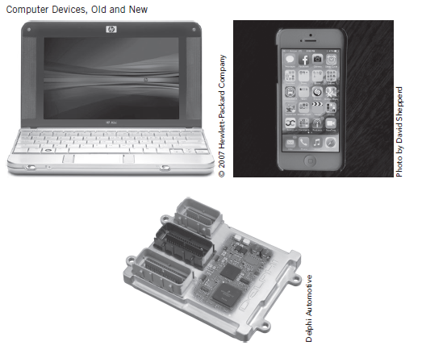
Computing Devices – Old and New
Copyright 2013 John Wiley & Sons, Inc.
1-<number>

Slide 3
Modern Computing
Computing is ubiquitous
  It is everywhere and anywhere
  No longer limited to a traditional ‘computer’
  Greater variety of computing platforms exist now
Computing is pervasive
  Embedded in many other types of devices such as appliances and automobiles
  Users no longer have to understand the details of how they work to operate the device
Copyright 2013 John Wiley & Sons, Inc.
1-<number>

Slide 4
Why Study Computer System Architecture?
User
  Understand system capabilities, strengths, and limitations
  Make better informed decisions
  Improve communications with information technology professionals
Programmer
  Create efficient application software for specific processing needs
Systems Architect or Systems Analyst
  Specify computer systems and architecture to meet application requirements
  Make intelligent decisions about system strategy
Copyright 2013 John Wiley & Sons, Inc.
1-<number>

Slide 5
Why Study Computer System Architecture?
Networking Professional
  Design, maintain, support, and manage networks
  Optimize equipment and network resources
Web Services Designer
  Optimize customer accessibility to Web services
  Optimize web system configurations
  Select appropriate data formats, page designs and scripting languages
  Design efficient Web pages
Copyright 2013 John Wiley & Sons, Inc.
1-<number>

Slide 6
Why Study Computer System Architecture?
System Administrator / Manager
  Install, configure, maintain, and upgrade computer systems
  Maximize system availability and efficiency
  Optimize system performance
  Select cloud services
  Ensure system security
Copyright 2013 John Wiley & Sons, Inc.
1-<number>

Slide 7
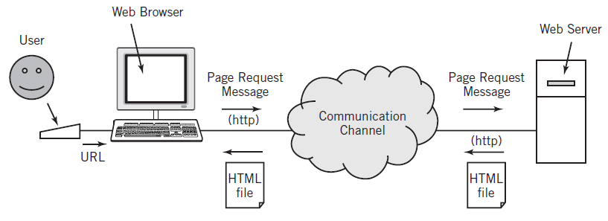
Web Browser Application Use
Copyright 2013 John Wiley & Sons, Inc.
1-<number>

Slide 8
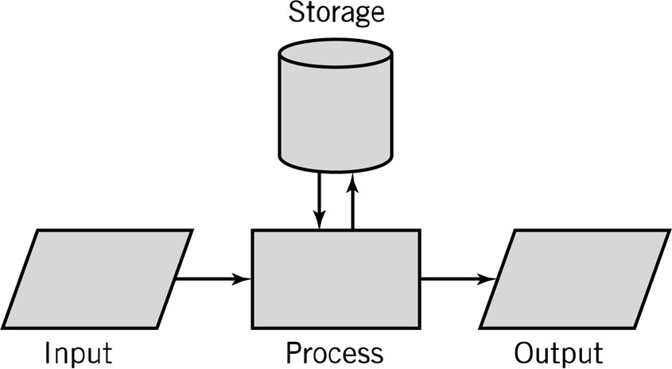
Input-Process-Output Model (IPO)
Input: keyboard, mouse, scanner
Processing: CPU executes the computer program
Output: monitor, printer, fax machine
Storage: hard drive, optical media, diskettes, magnetic tape
Copyright 2013 John Wiley & Sons, Inc.
1-<number>

Slide 9
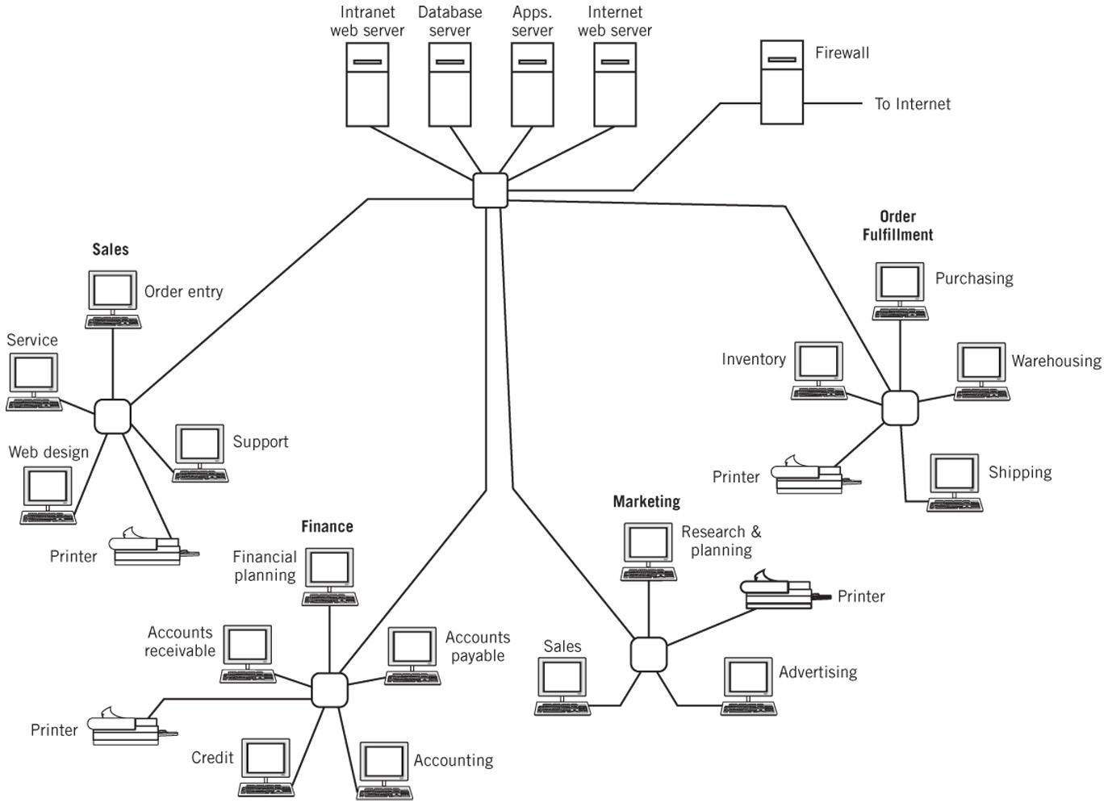
Simplified IT Computer System Layout
Copyright 2013 John Wiley & Sons, Inc.
1-<number>

Slide 10
Computer System Components
Hardware
  Processes data by executing instructions
  Provides input and output
  Control input, output, and storage components
Software
  Applications and system software
  Instructions tell hardware exactly what tasks to perform and in what order
Data
  Fundamental representation of facts and observations
Communications
  Sharing data and processing among different systems
Copyright 2013 John Wiley & Sons, Inc.
1-<number>

Slide 11
Hardware Component
Input/Output devices
Storage Devices
CPU – Central Processing Unit
  ALU: arithmetic/logic unit
  CU: control unit
  Interface unit
Memory
  Short-term storage for CPU calculations
Copyright 2013 John Wiley & Sons, Inc.
1-<number>

Slide 12
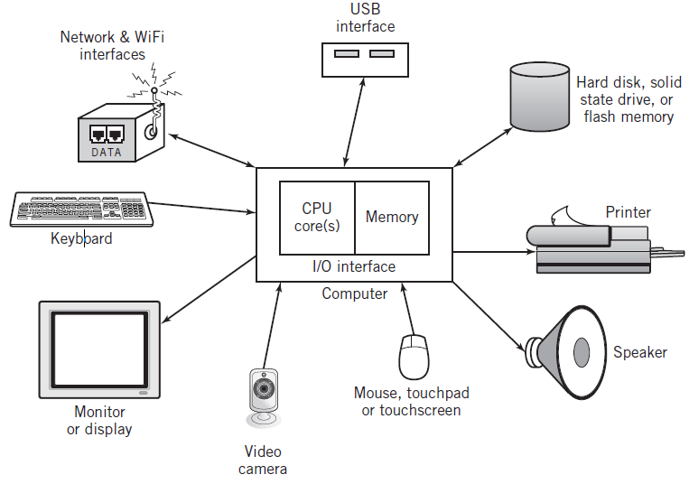
Typical Personal Computer System
Copyright 2013 John Wiley & Sons, Inc.
1-<number>

Slide 13
CPU: Central Processing Unit
ALU: arithmetic/logic unit
  Performs arithmetic and Boolean logical calculations
CU: control unit
  Controls processing of instructions
  Controls movement of data within the CPU
Interface unit
  Moves instructions and data between the CPU and other hardware components
  Bus: bundle of wires that carry signals and power between different components
Copyright 2013 John Wiley & Sons, Inc.
1-<number>

Slide 14
Memory
Also known as primary storage, working storage, and RAM (random access memory)
Consists of bits, each of which hold a value of either 0 or 1 (8 bits = 1 byte)
Holds both instructions and data of a computer program (stored program concept)
Copyright 2013 John Wiley & Sons, Inc.
1-<number>

Slide 15
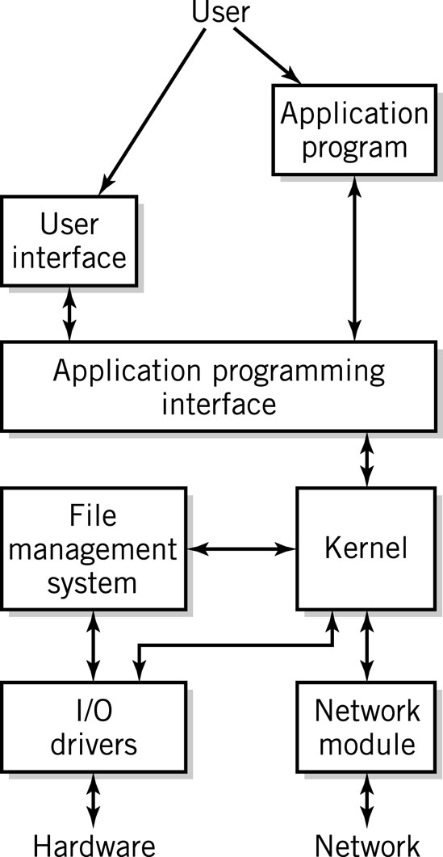
Software Component
Applications
Operating System
  API: application program interface
  File management
  I/O
  Kernel
    Memory management
    Resource scheduling
    Program communication
    Security
  Network Module
Copyright 2013 John Wiley & Sons, Inc.
1-<number>

Slide 16
Communication Component
Hardware
  Communication channels
    Physical connections between computer systems
    Examples: wire cable, phone lines, fiber optic cable, infrared light, radio waves
  Interface hardware
    Handles communication between the computer and the communication channel
    Modem or network interface card (NIC)
Software
  Establish connections
  Control flow of data
  Directs data to the proper applications for use
Copyright 2013 John Wiley & Sons, Inc.
1-<number>

Slide 17
Computer Systems
All computer systems, no matter how complex, consists of the following:
At least one CPU
Memory to hold programs and data
I/O devices
Long-term storage
Copyright 2013 John Wiley & Sons, Inc.
1-<number>

Slide 18
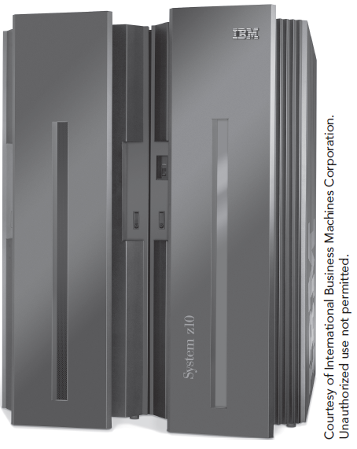
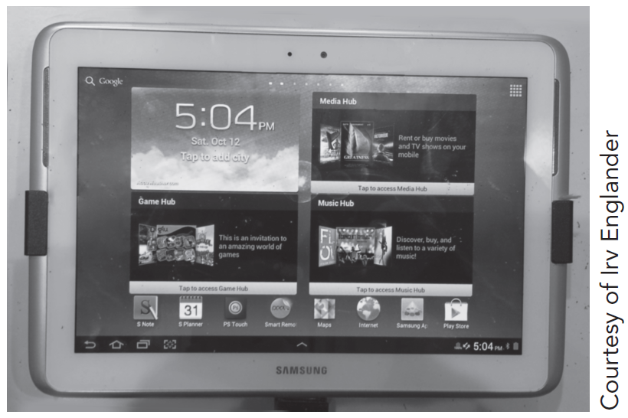
Computer Systems Examples
IBM System z10 EC Mainframe
Copyright 2013 John Wiley & Sons, Inc.
1-<number>

Slide 19
Virtualization
Virtual (American Heritage Dictionary
  Existing or result in essence or effect though not in actual fact, form or name
  Created, simulated, or carried on by means of a computer or computer network
Computer systems examples
  Virtual memory
  Virtual networks
  Java Virtual Machine
Copyright 2013 John Wiley & Sons, Inc.
1-<number>

Slide 20
Standards
Created to ensure universal compatibility of data formats and protocols
May be created by committee or may become a de facto standard through popular use
Examples:
  Computer languages: Java, SQL, C, JavaScript
  Display standards: Postscript, MPEG-2, JPEG, PNG
  Character set standards: ASCII, Unicode, EBCDIC
  Multimedia standards: MPEG-2, MPEG-4, MP3, DVD-ROM
Copyright 2013 John Wiley & Sons, Inc.
1-<number>

Slide 21
Protocols
Common ground rules of communication between computers, I/O devices, and many software programs
Examples
  HTTP: between Web servers and Web browsers
  TCP/IP: between computers on the Internet and local area networks
  SATA: between storage devices and computers
  XML,RSS, SIP: new protocols developed to meet new demands
Copyright 2013 John Wiley & Sons, Inc.
1-<number>

Slide 22
Textbook Overview
Web site: http://www.wiley.com/college/englander
Part 1 (Chapters 1-2)
  Overview of computer systems
Part 2 (Chapters 3-5)
  Number systems and data formats
Part 3 (Chapters 6-11)
  Computer architecture and hardware operation
Part 4 (Chapters 12-14)
  Networks and data communications
Part 5 (Chapters 15-18)
  Software component – operating systems
Part 6 (Supplementary Chapters S1-S4)
  Digital logic, systems examples, instruction addressing modes, programming tools
Copyright 2013 John Wiley & Sons, Inc.
1-<number>

Slide 23
Early History
1642: Blaise Pascal invents a calculating machine
1801: Joseph Marie Jacquard invents a loom that uses punch cards
1800’s:
  Charles Babbage attempts to build an analytical engine (mechanical computer)
  Augusta Ada Byron develops many of the fundamental concepts of programming
  George Boole invents Boolean logic
Copyright 2013 John Wiley & Sons, Inc.
1-<number>

Slide 24
Modern Computer Development
1937: Mark I is built (Aiken, Harvard University, IBM).
  First electronic computer using relays
1939: Atanasoff-Berry Computer (ABC) is built
  First fully electronic digital computer; used vacuum tubes
1943-46: ENIAC (Mauchly, Eckert, University of Pennsylvania).
  First general purpose digital computer
1945: Von Neumann architecture proposed
  Still the standard for present day computers
1947: Creation of the transistor
  (Bardeen, Shockley, Brattain, Bell Labs)
1951-2: EDVAC and IAS
Copyright 2013 John Wiley & Sons, Inc.
1-<number>

Slide 25
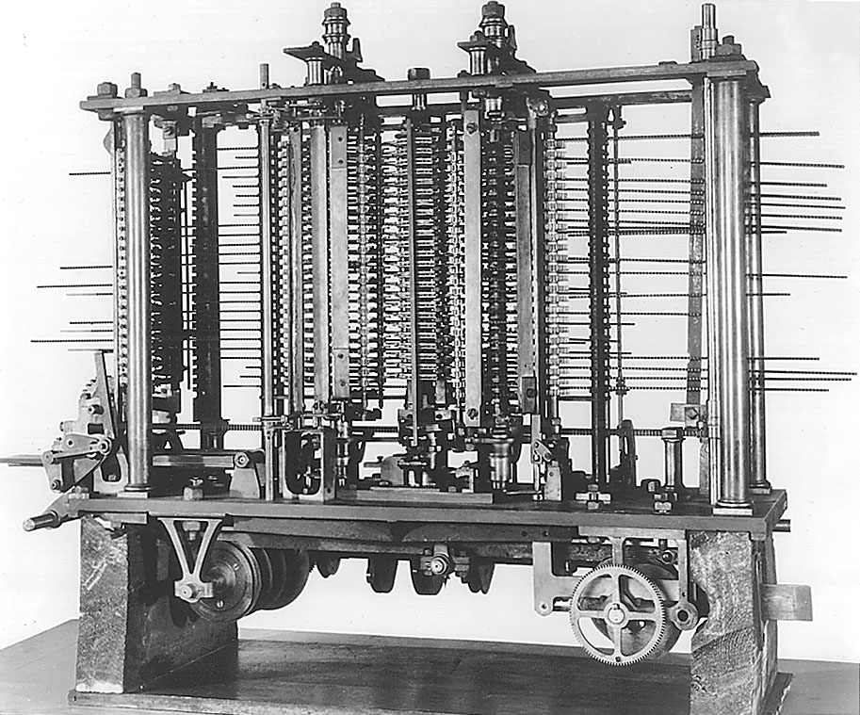
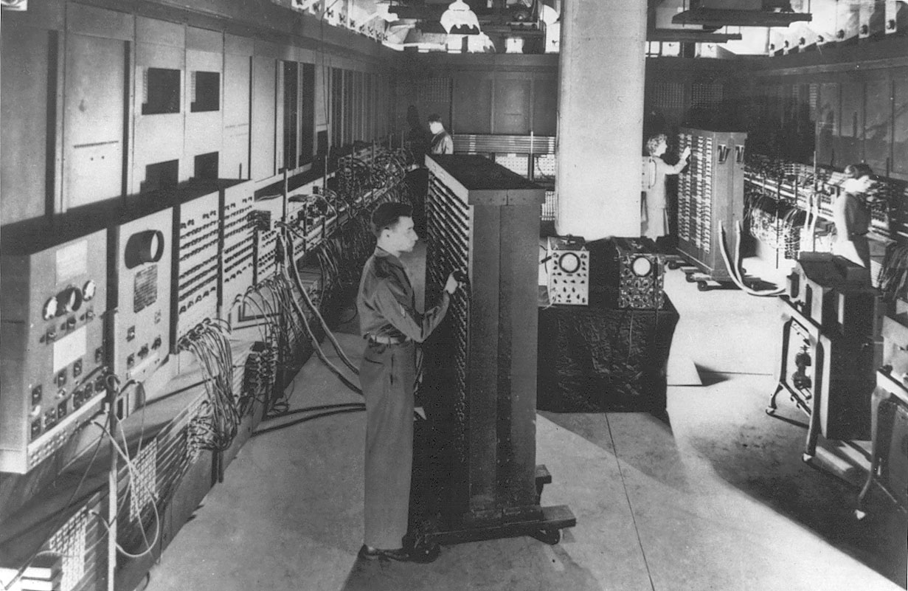
Early Computers
Babbage’s Analytical Engine
ENIAC
Copyright 2013 John Wiley & Sons, Inc.
1-<number>

Slide 26
System Software History
Early computers had no operating systems and were single user systems
  Programs were entered using switches for each bit or by plugging wires into a panel
1953-54: First operating system was built by General Motors Research Laboratories for their IBM 701 computer
Other early systems
  FORTRAN Monitor System (FMS)
  IBSYS
  Share Operating System (SOS)
Copyright 2013 John Wiley & Sons, Inc.
1-<number>

Slide 27
Operating System Development
1963: Master Control Program (MCP) by Burroughs
  Included many modern OS features
1964: OS/360 by IBM
  Included batch processing of programs
1962: MIT Project MAC created a time-sharing OS called CTSS
  Shortly afterwards, MIT, Bell Labs, and GE developed Multics (Multiplexed Information and Computing Services)
Copyright 2013 John Wiley & Sons, Inc.
1-<number>

Slide 28
UNIX
After Bell Labs withdrew from the Multics project, Ken Thompson developed a personal operating system called UNIX using assembly language
Dennis Ritchie developed the programming language C which was used to rewrite much of UNIX in a high-level language
UNIX introduced
  A hierarchical file system
  The shell concept
  Document production and formatting
  Tools for networked and distributed processing
Copyright 2013 John Wiley & Sons, Inc.
1-<number>

Slide 29
Graphical User Interfaces
1960s: Doug Englebart (Stanford Research Institute)
  Invented windows and a mouse interface
1970s: Xerox PARC
  Creates a practical windowing system for the Dynabook project
1980s: Steve Jobs (Apple)
  Developed the Apple Lisa and MacIntosh
Copyright 2013 John Wiley & Sons, Inc.
1-<number>

Slide 30
IBM PC
1982: Stand-alone, single user computer
PC-DOS, MS-DOS (disk operating system)
Later versions of DOS added
  Hierarchical directory file storage
  File redirection
  Better memory management
Windowing systems
  Windows 2.0, Windows 3.1, Windows 95
  Windows NT, Windows XP, Windows Vista
  Windows 7 and 8
Copyright 2013 John Wiley & Sons, Inc.
1-<number>

Slide 31
Communications
1960s and 1970s: users communicated on multiterminal computer systems using talk and email facilities
1971: Ray Tomlinson creates the standard username@hostname email standard
Modems permitted users to login to office systems, electronic bulletin board systems, Compuserve, AOL, and Prodigy
1969: ARPANET begun
1985: First TCP/IP wide area network
1991: Tim Berners Lee develops the concepts that become the World Wide Web
1993: Max Andreessen develops Mosaic, the first graphical browser
Copyright 2013 John Wiley & Sons, Inc.
1-<number>

Slide 32
Copyright 2013 John Wiley & Sons
All rights reserved. Reproduction or translation of this work beyond that permitted in section 117 of the 1976 United States Copyright Act without express permission of the copyright owner is unlawful. Request for further information should be addressed to the Permissions Department, John Wiley & Sons, Inc. The purchaser may make back-up copies for his/her own use only and not for distribution or resale. The Publisher assumes no responsibility for errors, omissions, or damages caused by the use of these programs or from the use of the information contained herein.”
Copyright 2013 John Wiley & Sons, Inc.
1-<number>

